Slide 1
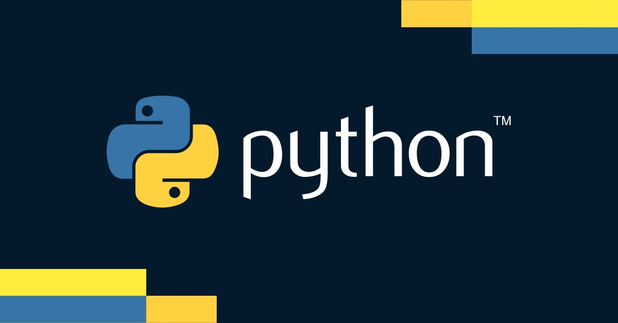

Slide 3

Introduction to NumPy
What is NumPy?
A powerful numerical computing library for Python
Provides support for arrays, matrices, and many mathematical functions
Why use NumPy?
Efficiently handle large datasets
Perform complex mathematical operations

Slide 4
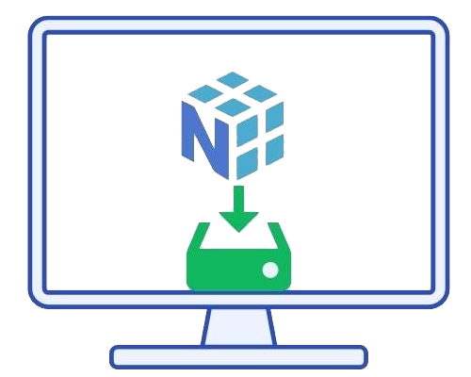


Installing NumPy
Using pip to install NumPy
Verifying the installation

Slide 5


Importing NumPy
Standard convention to import NumPy
Why use an alias?
Conciseness
Using np instead of long name makes the code shorter and easier to read
Convention
Widely accepted convention in Python community to use np for NumPy
Clarity
Helps in distinguishing between different libraries and your own code

Slide 6



Creating Arrays
Understanding array dimensions (1D, 2D, 3D)
Creating a NumPy array from a list
Creating 2D and 3D arrays

Slide 7




Array Attributes
Shape of an array
Data type of elements
Number of dimensions

Slide 8

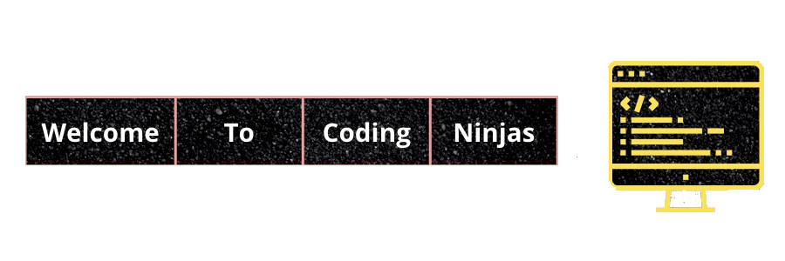
Array Initialization
Creating arrays with initial placeholders
Zeros array
Ones array
Empty array

Slide 9
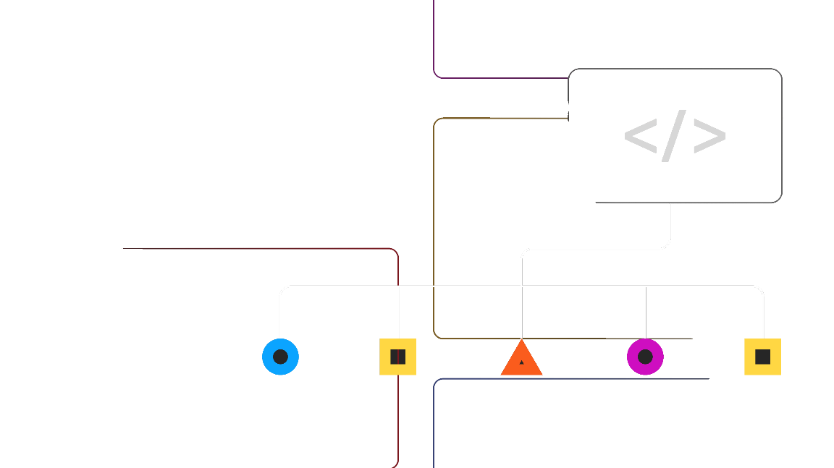
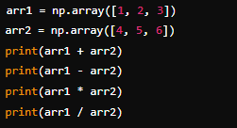

Array Operations
Basic arithmetic operations
Universal functions (ufuncs)

Slide 10



Array Indexing & Slicing
Accessing array elements
Slicing arrays

Slide 11
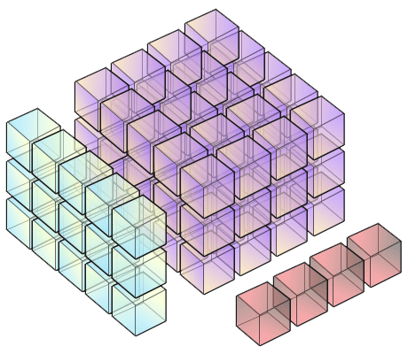


Array Manipulation
Concatenation of arrays
Splitting arrays

Slide 12

What is NumPy?
Numerical computing library that provides support for arrays, matrices, and many mathematical functions
What is the standard alias used when importing NumPy?
The standard alias used when importing NumPy is np
How do you create a NumPy array from a Python list [1, 2, 3]
np.array([1, 2, 3]
What function would you use to create a 3x3 array of zeros?
np.zeros((3, 3)

Slide 13





TASK 1
Create a 1D NumPy array with values from 10 to 50
Reshape this array into a 2D array with 4 rows and 10 columns
Calculate the mean and median of the 2D array
Slice the array to get a subarray consisting of the first two rows and the last three columns

